Slide 1
Readme
Update this deck to make it customer specific
Title slide
“Your data” section:
Forms versus variations slide: update numbers
Forms variations with managed code: update numbers
Forms with unsupported soap calls: update numbers
Forms with data connections: update numbers

Slide 2




InfoPath JDP program for <customer> – Self-service manual
<name>
<role>

Slide 3
Agenda
Introduction
Analysis approach
Remediation approach
Your data
Form Testing
Form Remediation
InfoPath Safe Driving rules

Slide 4
Introduction
SharePoint Online Dedicated customers are using a subset of InfoPath forms that stop working after migration to DvNext or MT
Microsoft is expanding the JDP (Joint Development Program) program to include InfoPath
You’ve opted to not participate in the program, but we wanted to share our data and approach with you

Slide 5
Guiding principles
InfoPath will continue to be supported on DvNext, MT and SP 2016 on-premises releases
Only a subset of forms use unsupported features, therefore, not all forms need to be remediated
The goal is to focus on the problematic forms that may cease to work properly after migration to DvNext

Slide 6
Recommended steps
Analysis
Planning
Remediation
You verify which of the forms you receive from us are still needed. Exclude forms of which you’re sure they’re not relevant, the other should be taken over to the planning step
You test the forms taking over from analysis: you would want to understand which forms will fail as these forms will require remediation
You remediate the forms which were flagged in the planning step. This remediation is done by if possible fixing the form, if that’s not possible then an alternative has to be developed

Slide 7
Analysis approach

Slide 8
Analysis process
Obtain data by reading all XSN files in all content databases and extract the relevant properties
Analyze extracted data and list “potential problematic” forms
Collect usage information for those “potential problematic” forms
Analyze code behind for those “potential problematic” forms

Slide 9
Potentially problematic forms
All forms with managed code
All forms with unsupported soap or rest calls
All forms that have a data connection (ado / bdc)
See https://support.microsoft.com/en-us/help/4017854 for a list of differences between InfoPath in on-premises vs InfoPath in SharePoint Online
Note:
Forms that only can be opened in InfoPath client are always marked as safe
Very old (InfoPath 2003 (version 11)) forms are marked as safe since they can only be opened by the client anyway

Slide 10
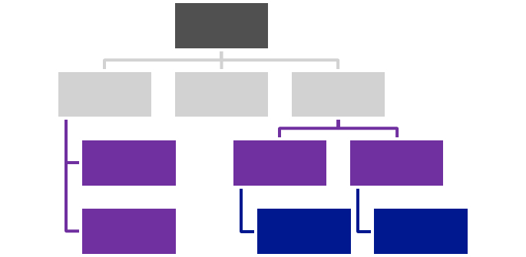
Forms vs variations vs usage
https://contoso.sharepoint.com/sites/site1
List A
Library1
List A
2
1
https://contoso.sharepoint.com/sites/site2
List B
Form
Variations (= copies / similar)
Usage

Slide 11
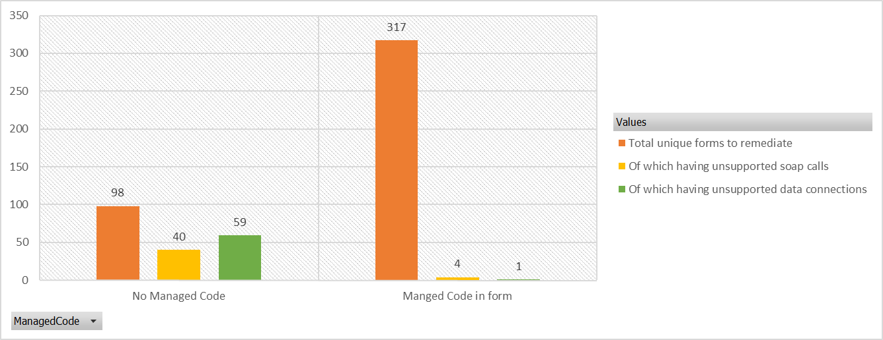
Potential problematic forms by root cause
317 of 415 forms have managed code (76%)
44 of 415 forms have unsupported soap calls (11%)
60 of 415 forms have unsupported data connections (14%)
Note: there are a few forms that have a combination of managed code, unsupported soap calls and unsupported data connections

Slide 12
Remediation approach

Slide 13
Remediation model
Forms variations
Scenarios
Remediation paths
Do nothing
Not used / not needed / not published
Archive
No recent usage
Redeploy
Forms that work after validation
Run in on-premises
SharePoint Add-In
Forms that require remediation
Azure Power Apps (*)
(*) Public preview: Q4 2015

Slide 14
Your data

Slide 15
Data format
Data will be delivered in Excel format
Excel sheet contains 4 sheets:
Dashboard = a set of Pivot charts providing insight in which types of problematic forms there are
Forms = contains the list of unique forms
Usage = contains the list of form variations combined with usage information
Code = contains the code analysis feedback in case a form variation was analyzed

Slide 16
Forms columns
Name | Source | Notes
Urn | Name property from <xsf:xDocumentClass | Unique key
InstanceCount | Scanning tools | Number of occurrences of forms with this urn
Urls | Scanning tools | Delimited list of xsn urls with this urn

Slide 17
Usage columns
Name | Source | Notes
Urn | Name property from <xsf:xDocumentClass | Unique key
InstanceCount | Hardcoded to 1 | An occurrence of this urn
Urls | Scanning tool | One xsn url with this urn
Move to planning | - | Answer this columns with yes if this form needs to move into the planning phase
Remediation Path | - | Fill the chosen remediation path for the forms taken over from the planning phase
UnsupportedSoapCalls | Scanning tool | Delimited list of unsupported soap calls
UnsupportedSoapCallsCount | Scanning tool | Count of unsupported soap calls
UnsupportedDataConnectionTypes | Scanning tool | Type of unsupported data connection (ado / bdc)
UnsupportedDataConnectionInstances | Scanning tool | Count of unsupported data connections

Slide 18
Usage columns
Name | Source | Notes
ManagedCode | ManagedCode element in SolutionDefintion element | Is there code behind (true/false)
ManagedCodeState | Version property of ManagedCode element | Remediation required for InfoPath version 2007 managed code (also version 2.0.0.0), validation required else
Mode | runtimeCompatibility property of SolutionDefintion element | “Client Server”, “Groove”, “Entity”, “List” = source of InfoPath usage. See slide notes for details
ProductVersion | productVersion property from xDocumentClass element | Version of InfoPath used for the last publishing
ListName | Manual data enrichment | Name of list detected based on the used url
ItemCount | Scanning tool | Number of items in the list (if available)
LastModifiedDate | Scanning tool | Last modification at list level (not at individual item level) ➔ less reliable
ItemCount > 100 | Manual data enrichment | More than 100 list items (if available)
ItemCountStatus | Manual data enrichment | Did we manage to grab the items?
Notes:
Mode:
Client Server = forms published to form libraries or content types that open in InfoPath Forms services. The most common type
List = forms used to “override” the default list forms
Groove = forms used via “ancient” groove customization…will be not relevant anymore as this functionality is anyway gone
Entity = forms used in BDC customizations. Most likely not relevant unless the specific BDC connections are recreated after migration to DvNext/MT

Slide 19
Code columns
Name | Source | Notes
Urn | Name property from <xsf:xDocumentClass | Unique key
InstanceCount | Scanning tools | Number of occurrences of forms with this urn
Urls | Scanning tools | Delimited list of xsn urls with this urn
Comments | Manual data enrichment | Comments on the code behind after inspection of the found binaries (inspection done use ILSpy)

Slide 20
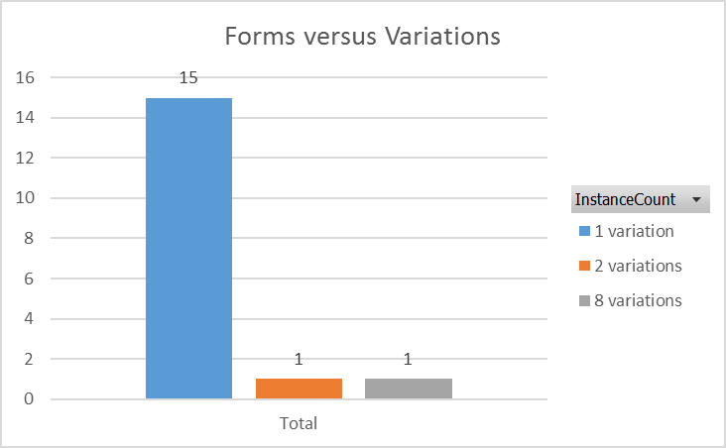
Forms versus variations
17 forms & 25 variations
Form Deployed… | # Forms | # Variations
1 time | 15 | 15
2 times | 1 | 2
8 times | 1 | 8
TOTALS | 17 | 25

Slide 21
Summary of Form Issues
21 variations have Managed Code
1 form variation has Unsupported SOAP Calls
4 form variations have Data Connections
Root cause | Form variations
Managed Code | 21
Unsupported soap calls | 1
Data connections | 4

Slide 22
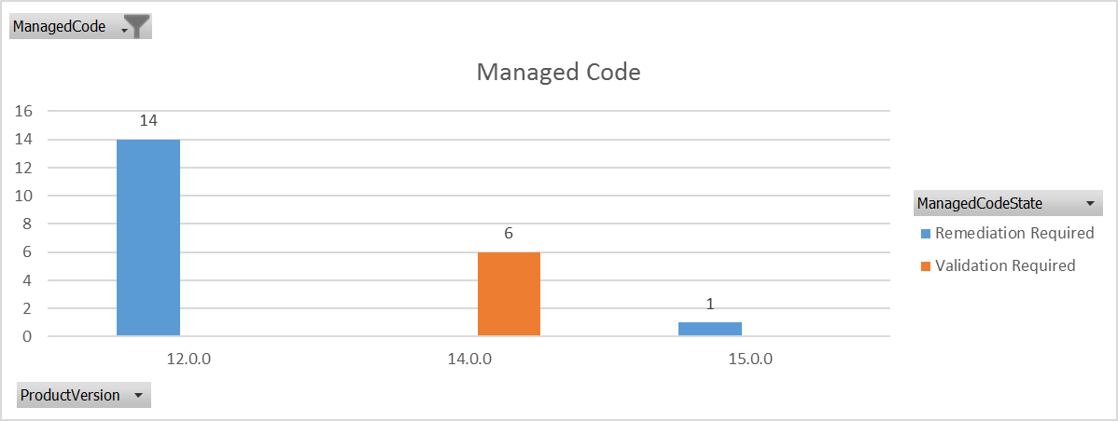
Forms variations with managed code
21 out of 25 variations have managed code
15 out of 21 are marked as “Remediation required”
6 out of 21 are marked as “Validation required”

Slide 23
Managed code details
See upcoming slides for more details on how to test
Update:
InfoPath forms with code behind depend on sandbox solutions with an assembly and these are not allowed anymore. All InfoPath forms with code behind must be updated!

Slide 24
InfoPath versus Sandboxed solutions
Forms with code behind typically use sandboxed solutions
Sandboxed solutions with code behind are deprecated: http://blogs.msdn.com/b/sharepointdev/archive/2014/01/14/deprecation-of-custom-code-in-sandboxed-solutions.aspx
Minimize usage of sandboxed solutions with code:
MUST: “Fix” forms with just “useless” code (e.g. empty event handlers)
MUST: Fix forms by removing the code dependency as these will not run in DvNext/MT
Sandboxed FTC proxies = FTC and as such not allowed in DvNext/MT
MUST: Remediate form to remove dependency on FTC proxy
No sandbox, but code behind = Administrator deployed forms
MUST: Remediation is required since these forms are not allowed in DvNext/MT

Slide 25
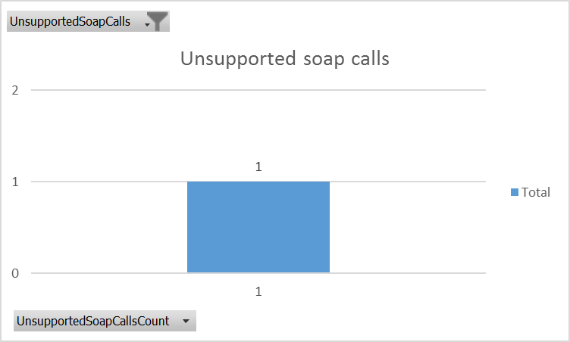
Forms with unsupported soap calls
1 out of 25 variations has unsupported soap calls
Root causes for failing soap calls are:
SharePoint loop back protection
Secured services
Unavailability of the “Authentication” section in the used UDCX files or embedded authentication in forms
Embedded credentials
Network setup in DvNext/MT
Using non publicly trusted SSL certificates

Slide 26
Root causes – loop back protection
In DvNext/MT there loop back protection enabled resulting in errors when services hosted on SharePoint call another service hosted by SharePoint
See https://support.microsoft.com/en-us/kb/2674193 and http://blogs.technet.com/b/rajbugga/archive/2013/08/07/infopath-over-claims-authentication-sharepoint-2010-amp-2013.aspx
This does *not* apply to SP2013 workflow as that’s running as a “supporting Azure service” thus outside of SharePoint

Slide 27
Root causes – loop back protection
List of “supported” services and their operations:
Lists.asmx
CheckOutFile
CheckInFile
Usergroup.asmx
GetUserCollectionFromGroup
GetUserCollectionFromSite
GetGroupCollectionFromWeb
UserProfileService.asmx
GetUserProfileByName
GetUserPropertyByAccountName
GetCommonManager
GetUserMemberships
GetCommonMemberships
Update:
Calling supported ASMX operations only works when the form uses the ASMX endpoint from the same site collection as the form is hosted into.

Slide 28
Forms using incompliant UDCX files
1 out of 25 variations uses uncompliant UDCX files:
Form uses UDCX file that points to ASMX endpoint hosted on a different site collection then the actual form. E.g. form is hosted on https://contoso.sharepoint.com/sites/HR whereas the UDCX points to an ASMX endpoint hosted in https://contoso.sharepoint.com
Root causes for incompliant UDCX files are:
UDCX files being copied/reused for new forms which are hosted in different site collections

Slide 29
Root causes – secured services
In DvNext/MT InfoPath Forms services cannot call protected services:
Adding credentials in the service request will fail
Using credentials or a secure store definition will not work as the “Authentication” section of the UDCX files is prohibited in DvNext/MT
Resolution:
Make services unauthenticated callable and provide additional “security date” as input parameters to the service (for custom services)
Create your own “proxy” service for existing SharePoint ASMX operations, see next slide for more details
Move away from InfoPath and create a SharePoint Add-In

Slide 30
How to call an “not supported” ASMX service
Suppose you want to call the “GetGroupCollectionFromUser” operation of UserProfileService.asmx:
Create a custom service endpoint (e.g. ASMXWrapper) with a method named GetGroupCollectionFromUser
Foresee string input parameters ClientId and ClientSecret next to the input parameters the original asmx operation had
Register this clientID/Secret combination in the farm by either making an app and installing it or by using appregnew.aspx/appinv.aspx (check the allow App-Only option)
Host this service endpoint anonymously
Adjust your existing InfoPath form to point to this new endpoint and hardcoded provide the client/secret combination in your form
In the service create an apponly clientcontext to talk back to SharePoint

Slide 31
Root causes – Network setup
InfoPath forms services is the SharePoint component that executes soap/rest calls
SP servers should be able to resolve the service host name
SP servers should be able to have a network path to the service endpoint

Slide 32
Root causes – Network setup - DNS
What’s the setup in “current” D:
Most customers have a private MPLS connection with MSFT
Customers have AD/DNS integration with MSFT via their private MPLS link
Result: SP servers can resolve hosts from internal customer DNS
What’s the setup in DvNext:
Most customers have a private MPLS/AER connection with MSFT
There’s *no* AD/DNS integration anymore
Result: SP servers cannot resolve hosts from internal DNS
Resolution:
Publish endpoints in public DNS (using internal IP addresses)

Slide 33
Root causes – Network setup - Path
What’s the setup in “current” D:
Most customers have a private MPLS connection with MSFT
Customers have AD/DNS integration with MSFT via their private MPLS link
Result: SP servers have a path towards services running in customer premises
What’s the setup in DvNext:
Most customers have a private MPLS/AER connection with MSFT
Network ACL’s might have changed in the new setup
Result: SP servers running in the MSFT datacenter cannot reach services running in customer premises
Resolution:
Validate network path (MSFT does not have ACL’s on outbound/inbound traffic in case of private MPLS/AER connection)

Slide 34
Root causes – Network setup - Certificates
What’s the setup in “current” D:
Customer issued certs might be deployed to SP farm trusted certs
Calling an service secured with a customer issued cert works
What’s the setup in DvNext/MT:
Only certificates issued by publicly trusted authorities are trusted
Calling services using a customer issued cert results in “The underlying connection was closed: Could not establish trust relationship for the SSL/TLS secure channel”
Resolution:
Switch service to use a publicly trusted certificate

Slide 35
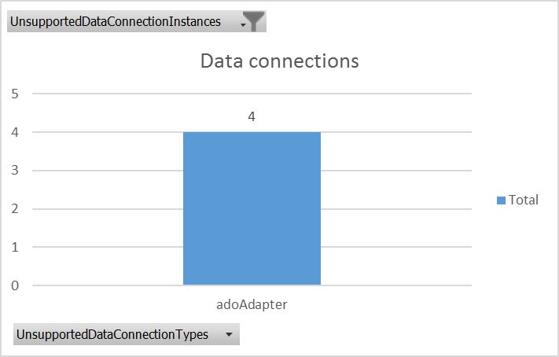
Forms with data connections
4 out of 25 variations have data connections that need to be validated
Root causes for failing data connections are:
Network setup in DvNext/MT
Unavailability of the “Authentication” section in the used UDCX files or embedded authentication in forms
Embedded credentials

Slide 36
Form Testing

Slide 37
Introduction
The forms listed are potentially problematic forms…testing is the only way to rule out things:
Some forms will simply work (forms with code marked as validation required)
Some forms can be made to work by changing / republishing them

Slide 38
Test environments
You’ve started the DvNext migration:
Test in a DvNext environment:
Create a test site collection and publish the needed forms in that site collection
Use the production DvNext environment if already available, if not use the current dry-run environment
You’ve already a OneDrive on DvNext:
Use your OneDrive site collection to test
DvNext migration still has to start:
Use an MT environment to test as this is the closest to the future DvNext environment

Slide 39
Basic testing approach

Slide 40
Testing approach: list forms
InfoPath forms used to replace the OOB add/edit list forms:
Create a list template from that list (List Settings → Save list as template)
Download the list template from the “List Template” gallery (Site Settings → List templates)
Upload into the “List Template” gallery of the test site collection
Create list based on the uploaded list template
Test the form

Slide 41
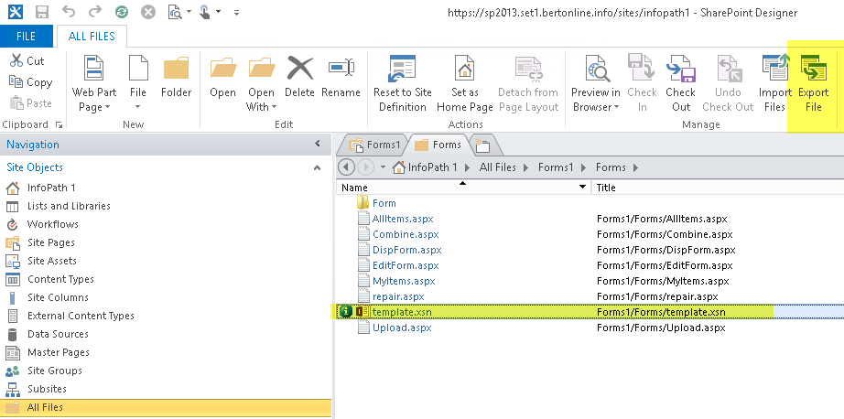
Testing approach: form library
Acquire the used InfoPath form (xsn file):
Form library: xsn is stored as template.xsn in the forms folder
Use SharePoint Designer to download the form:
Publish the form to a new library in the test site collection
Test the form

Slide 42
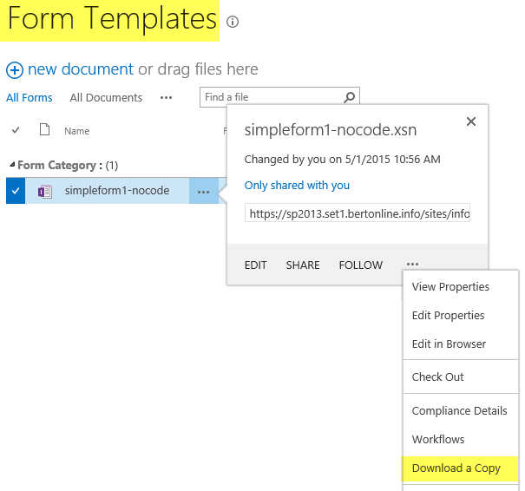
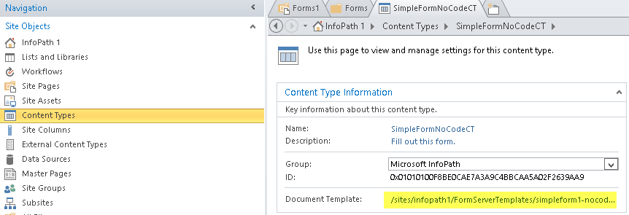
Testing approach: content type
Acquire the used InfoPath form (xsn file):
Content type: typically the form is stored in the FormServerTemplates library
Download using SharePoint UI
Publish the form to a new content type in the test site collection
Test the form
Note:
Use SharePoint Designer to find the form location if not in default location

Slide 43
Test flows

Slide 44
Testing flow – managed code
Validation Required?
Useless code only?
Works?
Test form
Done
Yes
No
Yes
Yes
No
Remove Useless code
No
Remediation needed!

Slide 45
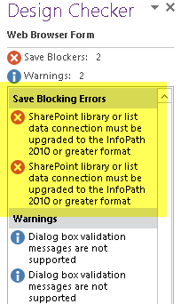
Testing forms with code behind
Forms with “useless” code:
See the “fix” guidance in this deck
Forms marked as “ValidationRequired”:
Can be republished from the InfoPath XSN file
UPDATE: these forms also require fixing since sandbox solutions with code are not allowed anymore
Forms marked as “RemediationRequired”:
Can not be simply republished as form needs to be upgraded to at least InfoPath 2010 level
You can face errors like shown in the image
See the “fix” guidance in the InfoPath JDP Remediation deck

Slide 46
Testing flow – unsupported soap calls
Custom soap service?
No authentication required?
Service host reachable?
Works?
Test form
Done
Yes
Yes
Yes
Yes
No
No
Supported OOB ASMX call?
No
No
Remediation needed!
No
Yes
Fix UDCX
Check input data

Slide 47
Testing forms with unsupported soap calls
Calling non SharePoint service:
Calling service requiring authentication: will not work. See the “fix” guidance in this deck
Calling other services: if service endpoint can be made reachable from DvNext / MT then this should work
Calling SharePoint ASMX services:
Service is part of the 10 supported calls listed on the next slide:
Remove the UDCX link or take over the UDCX file and remove the authentication section from that file
Ensure you do not call GetUserProfileByName with “empty” input: currently we’re working on getting this fixed, for now specifying the userName() as input is a workaround
Service is non supported SharePoint ASMX service:
See the “fix” guidance in this deck

Slide 48
Supported OOB ASMX soap calls
List of “supported” services and their operations:
Lists.asmx
CheckOutFile
CheckInFile
Usergroup.asmx
GetUserCollectionFromGroup
GetUserCollectionFromSite
GetGroupCollectionFromWeb
UserProfileService.asmx
GetUserProfileByName
GetUserPropertyByAccountName
GetCommonManager
GetUserMemberships
GetCommonMemberships

Slide 49
Testing flow – unsupported data connections
Connection still needed?
Works?
Remove connection
Test form
Done
No
Yes
Yes
No
Remediation needed!

Slide 50
Testing forms with unsupported data connections
These forms will not work due to database authentication limitations in DvNext / MT
See the “fix” guidance in this deck

Slide 51
Form Remediation

Slide 52
Two step model – try to fix or alternative
Fix existing form:
Fix form code
Fix soap calls
Develop alternative:
SharePoint Add-In
HTML + JavaScript
Fix data connections

Slide 53
Fixing the existing form

Slide 54
Keep using InfoPath - fixing flow
Managed Code?
Yes
No
2
Yes
Useless code only?
Unsupported soap calls?
Custom soap services?
1
Yes
Yes
No
3
No
No
Remediation Required?
Unsupported data connections?
ADO?
5
Yes
Yes
Yes
4

Slide 55
Basic fixing knowledge
Finding the XSN and using it…

Slide 56
Test environments
You’ve started the DvNext migration:
Test in a DvNext environment:
Create a test site collection and publish the needed forms in that site collection
Use the production DvNext environment if already available, if not use the current dry-run environment
You’ve already a OneDrive on DvNext:
Use your OneDrive site collection to test
DvNext migration still has to start:
Use an MT environment to test as this is the closest to the future DvNext environment

Slide 57

Approach: list forms
InfoPath forms used to replace the OOB add/edit list forms:
Create a list template from that list (List Settings → Save list as template)
Download the list template from the “List Template” gallery (Site Settings → List templates)
Upload into the “List Template” gallery of the test site collection
Create list based on the uploaded list template
Launch InfoPath Designer from the ribbon
Fix the form, republish and test

Slide 58
Approach: form library
Acquire the used InfoPath form (xsn file):
Form library: xsn is stored as template.xsn in the forms folder
Use SharePoint Designer to download the form
Fix the form
Publish the form to a new library in the test site collection and test

Slide 59
Approach: content type
Acquire the used InfoPath form (xsn file):
Content type: typically the form is stored in the FormServerTemplates library
Download using SharePoint UI
Fix the form
Publish the form to a new content type in the test site collection and test
Note:
Use SharePoint Designer to find the form location if not in default location

Slide 60
Removing code behind
1
The case of the “useless” code behind…

Slide 61
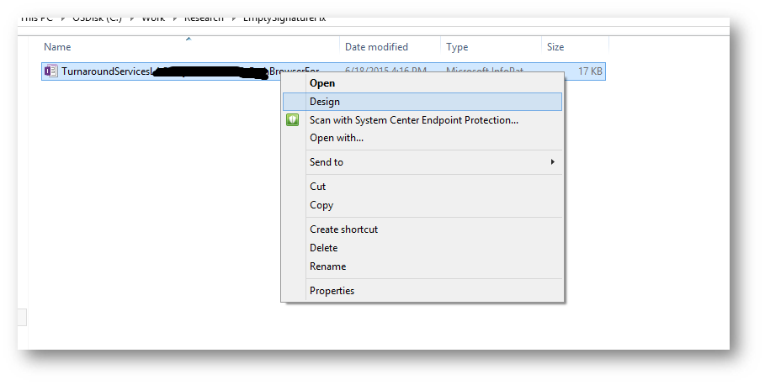
Step 1: Right click on InfoPath file and Click on “Design”

Slide 62
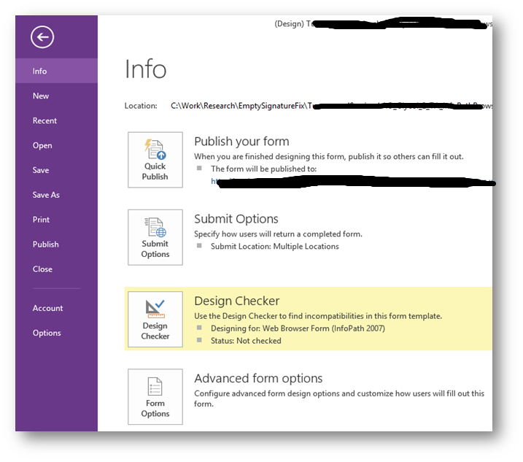
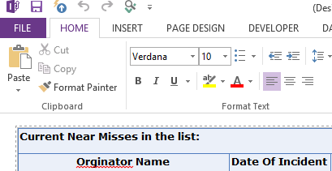
Step 2: Click on “File” menu Step 3: In Info page, click on “Form Options”

Slide 63
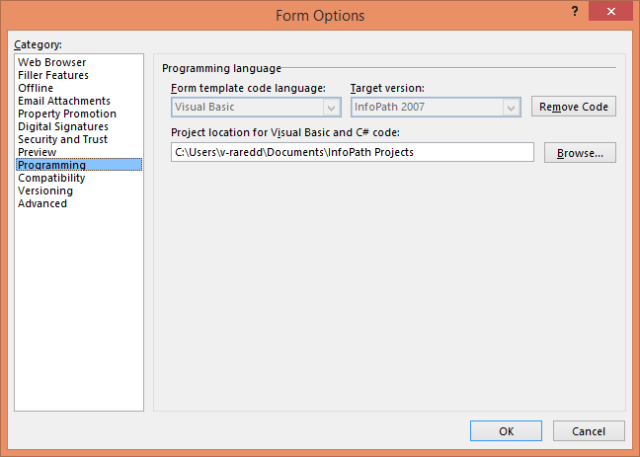
Step 4: In form options dialog, Click on “Programming” option.
Step 5: Click on “Remove Code” button

Slide 64
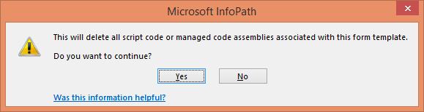
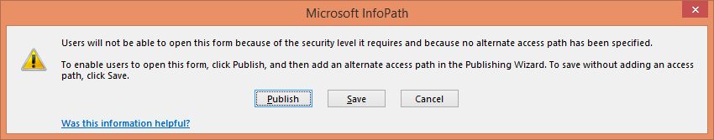
Step 6: In confirmation dialog, click “Yes” button to remove code.
Step 7: Click on “Save” button to save the updated InfoPath form locally Or click on “Publish” button to publish updated InfoPath form to SharePoint server.

Slide 65
Fixing forms with custom soap calls
2
In case you want to keep using InfoPath…

Slide 66
Keep using your custom service from InfoPath
Ensure the service host is reachable from SharePoint DvNext/MT
Ensure DNS resolving works
Ensure there’s a valid network path from SPO to the service location
Change the custom service to be reachable anonymously
Either fix the existing service
–or-
Build a proxy service that then calls the existing service

Slide 67
Calling custom soap service using the proxy model
DvNext / MT
Your Company
MPLS / Azure Express Route
2
2
SharePoint
Proxy
service
3
1
Public
DNS
Existing
Custom
service
Notes:
Resolve DNS for proxy service customservice.company.com from public DNS
Ensure the received IP address does route traffic over the private connection
InfoPath Forms services calls the proxy service end point
This call must be anonymous
Optionally provide a security token to which is “hardcoded” in the form and used to avoid anyone being able to call the service
Proxy service calls the existing custom service by authenticating via a service account

Slide 68
Fixing forms with “unsupported” soap calls + validation of “supported” soap calls
3
In case you want to keep using InfoPath…

Slide 69
Keep using “unsupported” SharePoint ASMX services
Suppose you want to call the “GetGroupCollectionFromUser” operation of UserProfileService.asmx:
Create a custom service endpoint (e.g. ASMXWrapper) with a method named GetGroupCollectionFromUser
Foresee string input parameters ClientId and ClientSecret next to the input parameters the original asmx operation had
Register this clientID/Secret combination in the farm by either making an app and installing it or by using appregnew.aspx/appinv.aspx (check the allow App-Only option)
Host this service endpoint anonymously and ensure it’s reachable from SPO (DNS/Network)
Adjust your existing InfoPath form to point to this new endpoint and hardcoded provide the client/secret combination in your form
In the service create an apponly clientcontext to talk back to SharePoint

Slide 70
Calling “unsupported” soap service
DvNext / MT
Your Company
MPLS / Azure Express Route
2
2
Client ID / Client secret
SharePoint
Client ID / Client secret
3
3
Proxy
service
1
See PnP-Transformation on github for a sample!
Public
DNS
https://teams.contoso.com/sites/infopath
Client ID / Client secret
Notes:
Resolve DNS for proxy service customservice.company.com from public DNS
Ensure the received IP address does route traffic over the private connection
InfoPath Forms services calls the proxy service end point
This call must be anonymous
InfoPath provides a registered clientID/secret combination (allowing app-only) when calling the proxy service.
Proxy service back to SharePoint to find the information originally acquired via the OOB ASMX service call (using CSOM preferably)
The received clientid/clientsecret can be used to instantiate an app-only clientcontext which allows to retrieve the needed information from SharePoint
This traffic again flows over the private connection

Slide 71
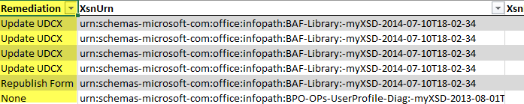
Calling “supported” ASMX services
Typically these are defined using UDCX files connected to the form
ASMX endpoint in connected UDCX file must refer to the same site collection as the form:
e.g. form is hosted on https://contoso.sharepoint.com/sites/HR whereas the UDCX points to an ASMX endpoint hosted in https://contoso.sharepoint.com will not work anymore
Use the “InfopathForms_CrossSiteWebService” report to verify this:
Update UDCX: fix url in UDCX file
Republish Form: form requires a new UDCX file which means republishing
None: no action needed

Slide 72
Fixing forms with ADO data connections
4
In case you want to keep using InfoPath…

Slide 73
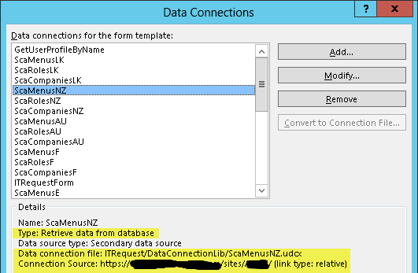
What’s the problem – authentication
Often an UDCX file is used to either define the credentials or to define a Secure Store ID or credentials are embedded in clear text
In DvNext / MT the “Authentication” element is blocked by design
+
Udcx file

Slide 74
The solution – authentication
Below options default to false and are not available in DvNext or MT:
Allow User Form Templates to use Authentication information contained in Data Connection Files
Allow Embedded SQL Authentication
Solution:
Create soap service that exposes the required SQL server data

Slide 75
Calling SQL Server (ADO data connection)
DvNext / MT
Your Company
MPLS / Azure Express Route
2
2
SharePoint
Proxy
service
3
1
Public
DNS
SQL
server
Notes:
Ensure SPO can resolve the database server name
InfoPath Forms services calls the proxy service end point
This call must be anonymous
Optionally provide a security token to which is “hardcoded” in the form and used to avoid anyone being able to call the service
Proxy service calls the SQL server database by authenticating via a service account

Slide 76
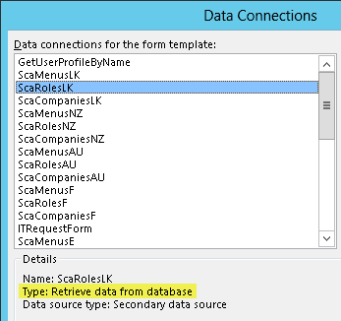
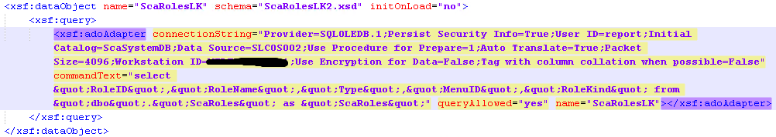
What’s the problem – network setup
The ADO data connection connects to a database on a defined SQL server.
Question to answer: is this SQL server reachable from SharePoint DvNext / MT?
=
Manifest.xsf

Slide 77
The solution – network setup
Ensure the service host is reachable from SharePoint DvNext/MT
Ensure DNS resolving works:
Requires using a hostname that can be defined in public DNS
Requires updating the impacted form
Ensure there’s a valid network path from SPO to the service location
Not relevant for direct InfoPath to SQL connection, but useful for BDC “External List” approach

Slide 78
Fixing forms with code marked as “Remediation Required”
5
In case you want to keep using InfoPath…
Forms with code behind do not work anymore and require remediation!

Slide 79
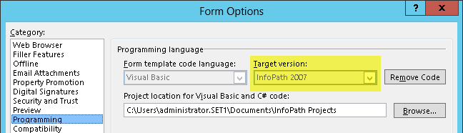
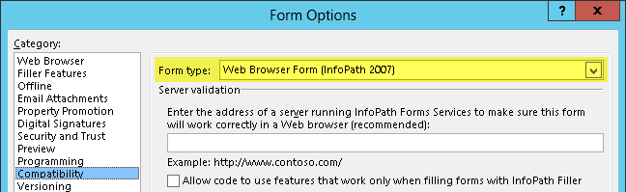
Why are forms marked as “Remediation required”?
Form type “Web browser Form (InfoPath 2007)” in combination with code version “InfoPath 2007” is not supported in DvNext or MT
+

Slide 80
The solution – manual approach
“Upgrade” the form to InfoPath 2013 level:
Code version “InfoPath 2010” or higher is required
Form type “Web browser Form (InfoPath 2007)” or higher is required
Pro:
form is ready for future updates
Con:
You need to have the original source code available for a recompile of the code
You’ll face upgrade errors because as of InfoPath 2010 another internal data connection structure is used ➔ these can be fixed
Potential compatibility issue with opening created instances when you moved from version 2007 Person/Group Pickers to 2010 based

Slide 81
The solution – manual approach
Upgrade guidance:
http://www.dotnetfunda.com/articles/show/2829/migrating-infopath-2007-form-to-2013-forms
http://blogs.msdn.com/b/infopath/archive/2010/04/08/upgrading-infopath-2007-forms-with-person-group-pickers-to-infopath-2010.aspx

Slide 82
Develop alternative solution

Slide 83
Helping you decide…
JavaScript + HTML
ASP.Net MVC or Forms Add-In
Flexibility
Average: calling authenticated services is harder
Excellent: everything is possible
Hosting requirements
None: hosted inside SharePoint and run in the user’s browser
Host needed: Azure web site (preferred) or on-premises IIS
Integration in SharePoint UI
Average: runs outside of SharePoint, basic chrome and branding can be taken over
Excellent: identical to InfoPath forms services
Good: uses Add-In infrastructure for deployment. List level integration requires custom code
Deployment
Average: requires custom code to deploy and update
1
2
3

Slide 84
Office 365 Developer Patterns & Practices
All created IP and guidance will be available via PnP
We’ve setup a dedicated github repository focused on transformation: https://github.com/OfficeDev/PnP-Transformation/tree/dev/InfoPath

Slide 85
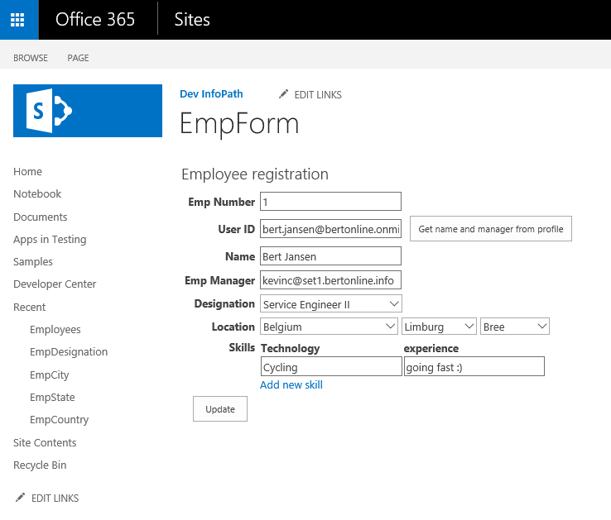
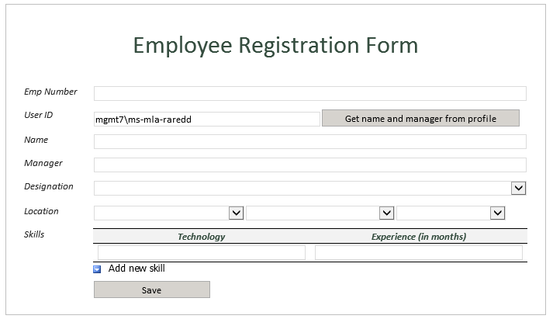
Single Page App (knockout.js)
1
See EmployeeRegistration on GitHub
See EmployeeRegistration.KnockOut.SinglePageApp on GitHub

Slide 86
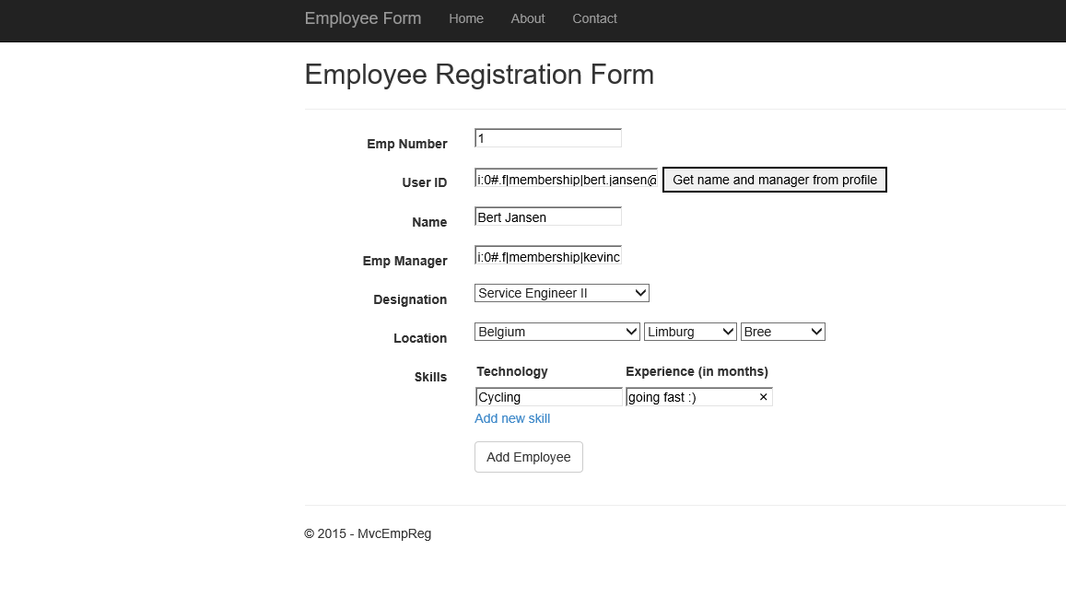
ASP.Net MVC
2
See EmployeeRegistration on GitHub
See EmployeeRegistration.MVC on GitHub

Slide 87
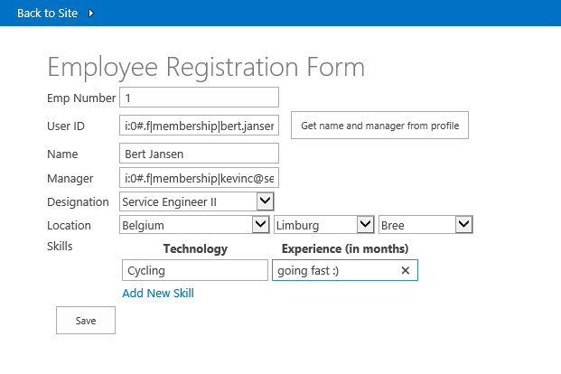
ASP.Net Forms
3
See EmployeeRegistration on GitHub
See EmployeeRegistration.Forms on GitHub

Slide 88
InfoPath Safe Driving rules

Slide 89
Introduction
The InfoPath JDP program is helping remediate problematic forms
This section offers InfoPath Safe Driving Rules: what are the InfoPath patterns that should be avoided in the future

Slide 90
Rule 1: Avoid code behind
Why:
Forms with code behind deploy their code using a sandboxed solution
Sandboxed solutions with code are deprecated in DvNext/MT and should be avoided if possible. See http://blogs.msdn.com/b/sharepointdev/archive/2014/01/14/deprecation-of-custom-code-in-sandboxed-solutions.aspx for more details are not allowed anymore.
Alternative approach:
Call out to a custom service that uses CSOM to perform the needed steps
Use an alternative approach like a SharePoint Add-In

Slide 91
Rule 2: Avoid using SharePoint ASMX/REST services
Why:
SharePoint DvNext/MT has loop back protection enabled causing most calls to SharePoint hosted services (ASMX/REST) to fail. A subset of ASMX services and operations is supported. See https://support.microsoft.com/en-us/kb/2674193 for details.
Alternative approach:
Call out to a custom service that uses CSOM to perform the needed steps. Keep in mind that this customer service cannot require authentication as that’s not possible from InfoPath Form Services in DvNext/MT
Use an alternative approach like a SharePoint Add-In

Slide 92
Supported ASMX services and operations
List of “supported” services and their operations:
Lists.asmx
CheckOutFile
CheckInFile
Usergroup.asmx
GetUserCollectionFromGroup
GetUserCollectionFromSite
GetGroupCollectionFromWeb
UserProfileService.asmx
GetUserProfileByName
GetUserPropertyByAccountName
GetCommonManager
GetUserMemberships
GetCommonMemberships

Slide 93
Rule 3: Avoid reusing UDCX files across site collections
Why:
SharePoint DvNext/MT has can call a set of supported ASMX services (see prev rule) but only when they’re called from the same site collection as the one hosting the form. Reusing UDCX files from other forms hosted on other site collections works in on-premises but fails in online
Alternative approach:
Give each site collection their own UDCX files

Slide 94
Rule 4: Ensure hostnames are DNS resolvable by the SP farm
Why:
There’s no AD/DNS level integration in DvNext/MT, also not when a private peering (MPLS/AER) connection is used.
SharePoint DvNext/MT does only resolve DNS from public DNS
Alternative approach:
Register your internal services in public DNS with an IP address that’s routed via the connection (MPLS/AER/Internet) you need

Slide 95
Rule 5: Ensure your custom services are reachable by the SP farm
Why:
Network ACL’s at customer side might block traffic and make your custom service not reachable
Alternative approach:
Ensure that the resolved IP address of the service is reachable from the SP servers. This might mean opening up ACL’s in your network configuration

Slide 96
Rule 6: Secure your custom services using a publicly trusted certificate
Why:
In D a custom certificate might be deployed to the farms trusted certs. In DvNext/MT we only allow public trusted certs…so services secured with a custom cert will result in SSL errors
Alternative approach:
Secure your custom services using a publicly trusted certificate

Slide 98

© 2014 Microsoft Corporation. All rights reserved. Microsoft, Windows, Windows Vista and other product names are or may be registered trademarks and/or trademarks in the U.S. and/or other countries.
The information herein is for informational purposes only and represents the current view of Microsoft Corporation as of the date of this presentation. Because Microsoft must respond to changing market conditions, it should not be interpreted to be a commitment on the part of Microsoft, and Microsoft cannot guarantee the accuracy of any information provided after the date of this presentation. MICROSOFT MAKES NO WARRANTIES, EXPRESS, IMPLIED OR STATUTORY, AS TO THE INFORMATION IN THIS PRESENTATION.

